Slide 1

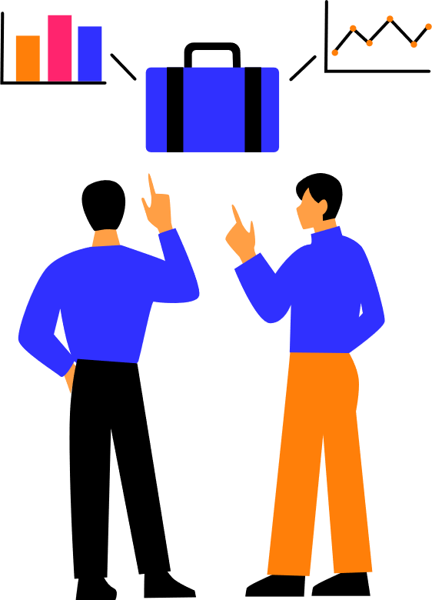

NAME-KRISH THAKUR
SUBJECT- WEB ANALYTICS
COURSE-BBA-DM
ROLL.NO-122124005

Slide 2


TABLE OF CONTENTS
What are UTM Parameters?
Sample UTM URL
Differentiate between UTM parameters with examples.
Importance in Google Analytics
YouTube Ad Campaign Example
Common Mistakes & Solutions
Conclusion

Slide 3

What are UTM Parameters?
UTM parameters as simple "tags" or labels that you add to the end of a website link (URL). These tags don't change the destination of the link, but they tell your analytics software, like Google Analytics, exactly where the person who clicked the link came from.
The name "UTM" comes from "Urchin Tracking Module," which was the software that Google acquired to create Google Analytics.
A link with UTM parameters might look like this:
www.example.com?utm_source=facebook&utm_medium=social&utm_campaign=summer_sale.
Their Role in Digital Marketing Campaigns :-
Precise Tracking: They allow you to see exactly which campaigns, ads, or posts are driving traffic to your website. Instead of just knowing that "100 people came from Facebook," you can know that "70 people came from the summer sale ad on Facebook, and 30 came from the link in our profile.“
Measuring ROI (Return on Investment): By tracking which links lead to sales or sign-ups, you can figure out which campaigns are actually making you money. This helps you decide where to invest your marketing budget for the best results.
A/B Testing: You can use UTM parameters to test different versions of an ad or email. For example, you can create two ads with different images but the same link, and use the utm_content tag to see which image gets more clicks and conversions.
Better Decision Making: Overall, they provide clear data that helps you understand what is effective and what is not. This allows you to stop wasting money on marketing activities that don't work and double down on the ones that do.

Slide 4


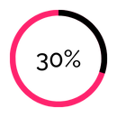
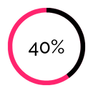
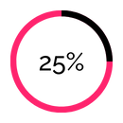
The Solution
Results:
Better forecasts
Time saved on reporting
Time saved on reporting
A single platform to manage budgets, campaigns, sales, and strategies with real-time, automated insights.

Slide 5

Differentiate between UTM parameters with examples
UTM Source – Tells you where the traffic comes from. Example: facebook, google, newsletter.
Link example: www.example.com?utm_source=facebook
Here, you know visitors came from Facebook.
UTM Medium – Shows how the traffic arrived. Example: email, social, cpc (paid ads).
Link example: www.example.com?utm_medium=email
You know it came via an email campaign.
UTM Campaign – Names the specific campaign. Example: summer_sale, new_launch.
Link example: www.example.com?utm_campaign=summer_sale
Helps track which campaign brings results.
UTM Term – Used in paid ads to see which keyword brought visitors. Example: shoes, laptop.
Link example: www.example.com?utm_term=shoes
UTM Content – Differentiates links or ads within the same campaign. Example: ad1, ad2, banner1.
Link example: www.example.com?utm_content=ad1
Shows which ad or button was clicked.

Slide 6

Importance in Google Analytics
See the Full, Clear Picture - Without UTMs, Google Analytics might just say "100 people came from Facebook." With UTMs, it can tell you "70 people came from your Diwali sale ad on Facebook, and 30 came from the link in your profile." It turns vague data into specific, useful information.
Know Exactly What's Working-UTMs allow you to pinpoint which specific ads, emails, or social media posts are successfully bringing visitors and leading to sales. You can measure the performance of each individual marketing effort.
Spend Your Budget Wisely - When you know which campaigns are performing the best, you can confidently invest more money in them. It helps you stop wasting your budget on ads or strategies that aren't bringing results.
Improve Your Marketing - UTMs are perfect for testing. You can create two different ads for the same campaign and use a UTM tag to see which one gets more clicks and conversions. This helps you understand what your audience responds to.
Attribute Sales Correctly - They ensure that the credit for a sale or sign-up goes to the right campaign. This is crucial for understanding the true value and return on investment (ROI) of your marketing activities.

Slide 7

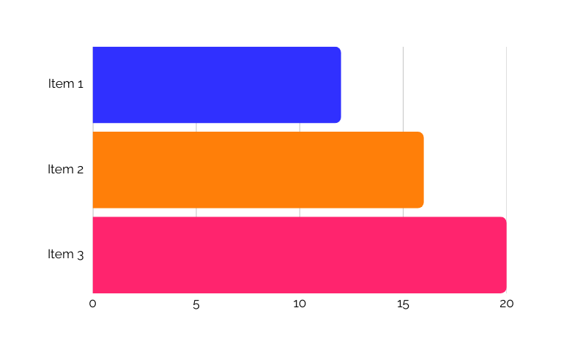

Market Opportunity
Trends:
SMEs worldwide are adopting digital tools rapidly yet many lack an integrated platform.
22.5% CAGR in SME SaaS adoption
$33B BI market in 2024 - $70B+ by 2029
85% of enterprises prioritize digital integration

Slide 8

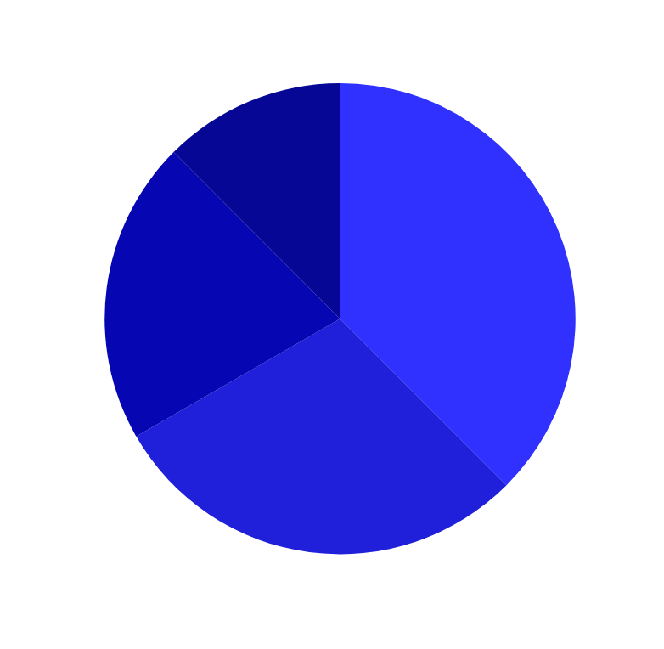
Flexible plans fit all business sizes. Monetization focuses on value and scale.
Business Model
Revenue Streams:
  Add-ons (20%)
  Subscriptions (65%)
  Advisory Services (5%)
  Enterprise Licensing (10%)

Slide 9

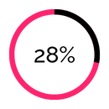
Go-To-Market Strategy
Data-driven campaigns and partner networks drive growth.
Channels:
  Referral Incentives
  Strategic Partnerships
  Webinars & Live Demos
  Content & Digital Marketing
Demo-to-signup rate
CAC reduction

Slide 10
We combine intelligence, usability, and scalability in one platform.
Common Mistakes | How to Avoid Them
Inconsistent Naming | Standardize naming: use all lowercase letters and agree on separators (like dashes or underscores). Treat “facebook” and “Facebook” as different.
Confusing Source and Medium | Define roles clearly: Source = where traffic comes from (facebook, google, newsletter). Medium = how it arrived (social, cpc, email).
Tagging Internal Links | Use UTMs only for external traffic. Avoid adding UTMs to your own website links as it overwrites the original source and creates false sessions.
Typos (Typographical Error) and Syntax Errors | Use a UTM builder tool to create links automatically. This ensures correct formatting with ? and & symbols.
Vague Campaign Names | Be specific: use descriptive campaign names like summer_sale_email_v1 instead of generic names like sale to easily identify campaigns later.

Slide 11





Investment Ask
We seek $2.5M to scale our product, team, and market reach.
Product Development
Customer Success
Marketing
and sales
Hiring Global Staff
Sales Enablement

Slide 12



The Team
Richard Sanchez
Korina Villanueva
Morgan Maxwell
CEO – Strategy & Growth
CTO – Product & Engineering
Head of Marketing
10+ years scaling digital ventures with a data-first mindset.
Built cloud-native platforms and led enterprise AI projects.
Multi-channel campaign expert driving user acquisition.

Slide 13
THANK YOU

